Slide 1
Python for Data Analysis
Sai nikhilesh kasturi

Slide 2
AGENDA
What is Data science ?
Why python ?
Overview of Python Libraries for Data Scientists
Reading Data; Selecting and Filtering the Data; Data manipulation, sorting
Plotting the data
Exercises in jupyter notebook
Questions ?

Slide 3
What is Data Science?
Data science is all about finding and exploring data in the real world and using that knowledge to solve business problems. Some examples of data science are:
Customer Prediction - System can be trained based on customer behavior patterns to predict the likelihood of a customer buying a product.
Service Planning - Restaurants can predict how many customers will visit on the weekend and plan their food inventory to handle the demand.
Recommendation systems - creation of recommendation systems using different machine learning models which helps in predicting the shoppers needs and show the products the shopper is most likely to buy.
Now that you know what data science is and before we get deep into the topic of Data Science with Python is let’s talk about Python.

Slide 4
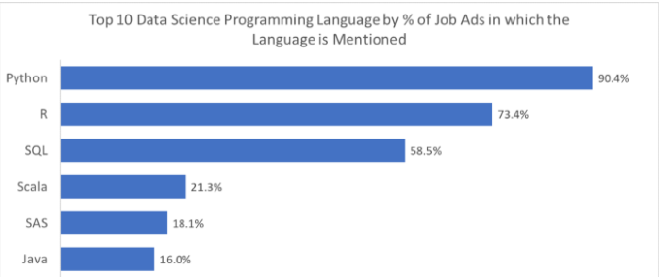
Why python ?
Open source – which means it is free. ☺
Speed - Python is relatively faster than other programming languages.
Availability - There are a significant number of packages available that other users have developed, which can be reused.
Design goal - The syntax roles in Python are intuitive and easy to understand, thereby helping in building applications with a readable codebase.
Many more…..

Slide 5
Python Libraries for Data Science
if you want to perform data analysis, you need to import specific libraries. Some examples include:
Pandas - Used for structured data operations.
NumPy - A powerful library that helps you create n-dimensional arrays.
SciPy - Provides scientific capabilities, like linear algebra and Fourier transform.
Matplotlib - Primarily used for visualization purposes.
Scikit-learn - Used to perform all machine learning activities.
Many more…

Slide 6
NumPy
introduces objects for multidimensional arrays and matrices, as well as functions that allow to easily perform advanced mathematical and statistical operations on those objects.
provides vectorization of mathematical operations on arrays and matrices which significantly improves the performance.
many other python libraries are built on NumPy.

Slide 7
SCIpy
collection of algorithms for linear algebra, differential equations, numerical integration, optimization, statistics and more.
It has fully-featured versions of the linear algebra modules
built on NumPy.

Slide 8
Pandas
The most useful data analysis library in Python.
Instrumental in increasing the use of Python in the data science community.
Pandas is used for structured data operations and manipulations.
provides tools for data manipulation: reshaping, merging, sorting, slicing, aggregation etc.
allows handling missing data
Used extensively for data mugging and preparation.

Slide 9
SciKit-Learn
provides machine learning algorithms: classification, regression, clustering,
model validation etc.
built on NumPy, SciPy and matplotlib.

Slide 10
matplotlib
python 2D plotting library which produces publication quality figures in a variety of hardcopy formats
line plots, scatter plots, barcharts, histograms, pie charts etc.
relatively low-level; some effort needed to create advanced visualization

Slide 11
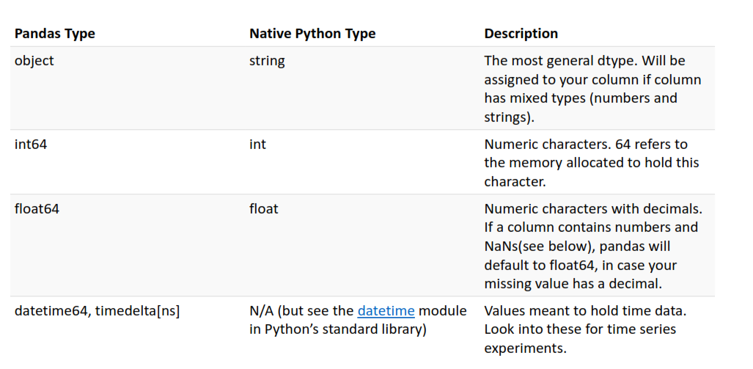
Data Frame data types

Slide 12
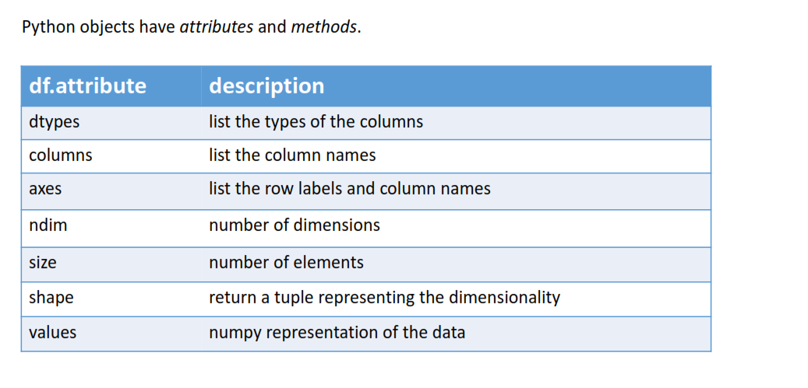
Data Frames attributes

Slide 13
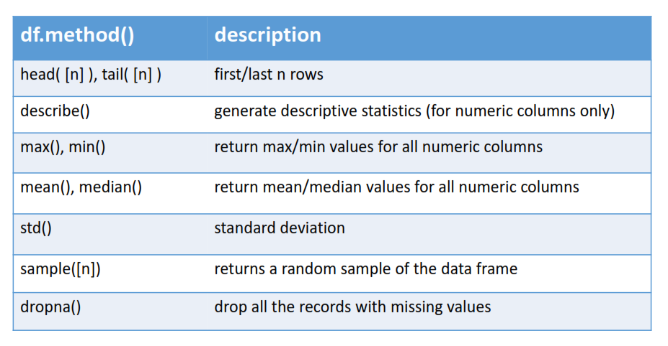
Data Frames methods

Slide 14
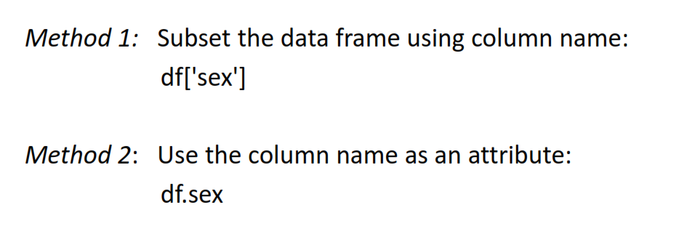
Selecting a column in a Data Frame

Slide 15
Data Frame: filtering
To subset the data we can apply Boolean indexing. This indexing is commonly known as a filter.
For example if we want to subset the rows in which the age is greater than 35.
Lets go back to our jupyter notebook.
Any Boolean operator can be used to subset the data:
> greater; >= greater or equal;
< less; <= less or equal;
== equal; != not equal;

Slide 16
Data Frames: Slicing
There are a number of ways to subset the Data Frame:
one or more columns
one or more rows
a subset of rows and columns
Rows and columns can be selected by their position or label

Slide 17
Data Frames: Slicing
When selecting one column, it is possible to use single set of brackets, but the resulting object will be a Series (not a DataFrame):
When we need to select more than one column and/or make the output to be a Data Frame, we should use double brackets:
Lets go to Jupyter Notebook and check this. ☺

Slide 18


